Slide 1
Restaurant & Consumer Data Analysis using MySQL

Slide 2
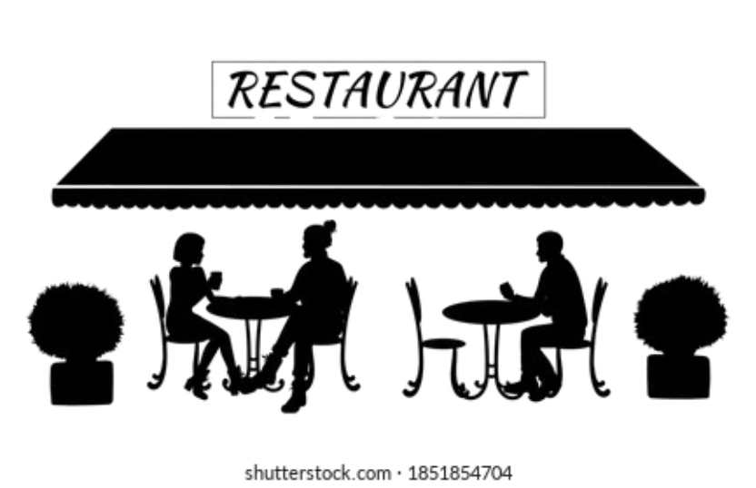
Project Statement
The project focuses on analyzing restaurant and consumer data using MySQL.
Build a structured relational database for restaurant and consumer data
Perform data exploration and analysis using SQL queries
Derive insights on cuisines, ratings, and consumer behavior
Aimed to understand customer preferences and restaurant performance to help make data-driven decisions for better service and business growth.
Demonstrate end-to-end SQL workflow — from schema design to advanced analysis

Slide 3
Schema Explanation
ENTITIES : Consumers: Info like age, budget, occupation, and city. Restaurants: Info like city, price, alcohol service, parking. Ratings: Overall, food, and service ratings by each consumer. Consumer_Preferences: Cuisines liked by each consumer. Restaurant_Cuisines: Cuisines served by each restaurant. Relationships: One consumer can rate multiple restaurants. One restaurant can have multiple cuisines. One consumer can prefer multiple cuisines.

Slide 4
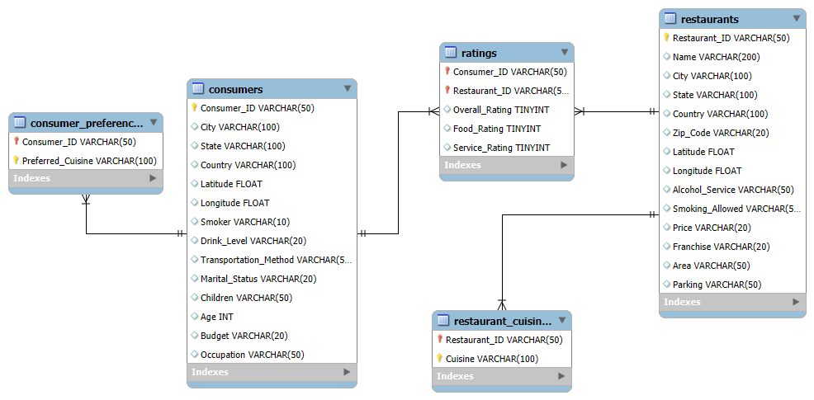
ER Diagram

Slide 5
Key analysis questions (use cases)
City-wise Performance:
Which cities have restaurants with the highest average ratings?
Student Preferences:
What are the top 3 cuisines preferred by low-budget students?
Restaurant Insights:
Which restaurants perform above the overall average rating?
Consumer Behavior:
Which consumers give higher or lower ratings compared to others?
Budget vs Rating:
How does the consumer’s budget (Low, Medium, High) affect their restaurant ratings?
Service & Satisfaction:
Does alcohol service (“Wine & Beer”) influence overall satisfaction?
Cuisine Popularity:
Which cuisines are most popular and highly rated across all cities?
Performance Comparison:
How do individual consumer ratings compare to each restaurant’s average rating?

Slide 6
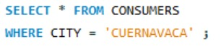
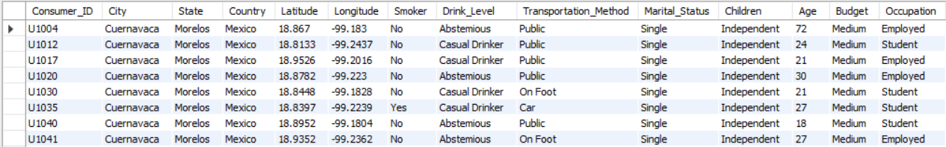
WHERE Clause :
1. List all details of consumers who live in the city of 'Cuernavaca'

Slide 7
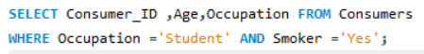
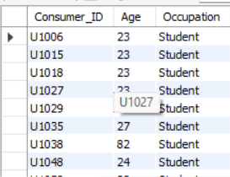
2. Find the Consumer_ID, Age, and Occupation of all consumers who are 'Students' AND are 'Smokers'.

Slide 8
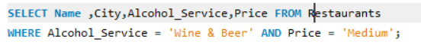
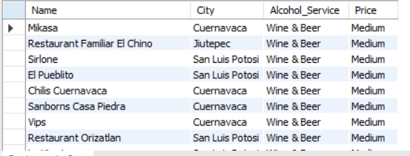
3. List the Name, City, Alcohol_Service, and Price of all restaurants that serve 'Wine & Beer' and have a 'Medium' price level.

Slide 9
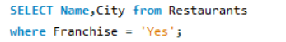
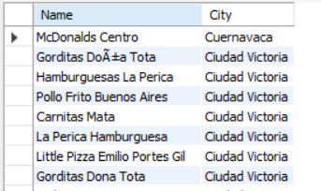
4. Find the names and cities of all restaurants that are part of a 'Franchise'.

Slide 10
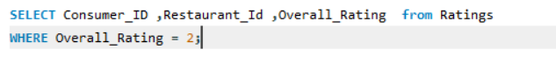
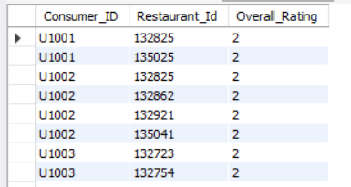
5 . Show the Consumer_ID, Restaurant_ID, and Overall_Rating for all ratings where the Overall_Rating was 'Highly Satisfactory'
(which corresponds to a value of 2, according to the data dictionary).

Slide 11
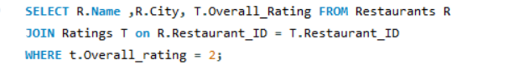
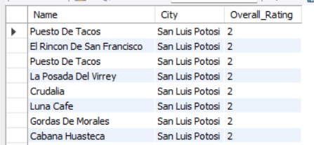
JOINS AND SUBQUERIES :
1. List the names and cities of all restaurants that have an Overall_Rating of 2 (Highly Satisfactory) from at least one consumer.

Slide 12
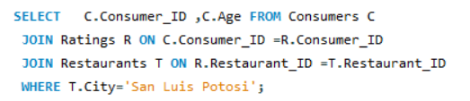

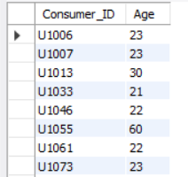
2. Find the Consumer_ID and Age of consumers who have rated restaurants located in 'SanLuis Potosi'.

Slide 13
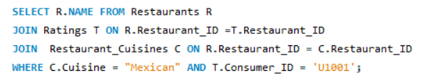

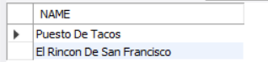
3. List the names of restaurants that serve 'Mexican' cuisine and have been rated by consumer 'U1001'.

Slide 14
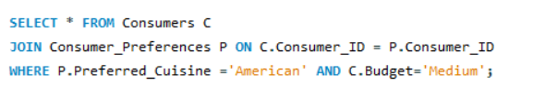
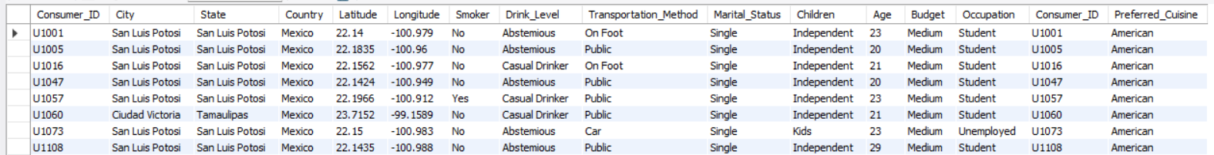
4.Find all details of consumers who prefer 'American' cuisine AND have a 'Medium' budget.

Slide 15
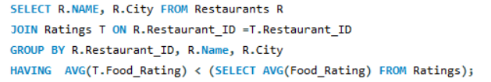
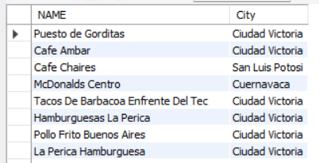
5. List restaurants (Name, City) that have received a Food_Rating lower than the average Food_Rating across all rated restaurants.

Slide 16
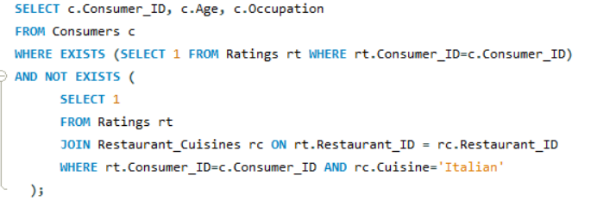
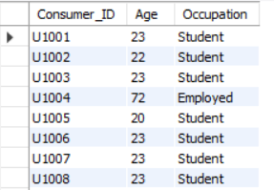
6. Find consumers (Consumer_ID, Age, Occupation) who have rated at least one restaurant but have NOT rated any restaurant that serves 'Italian' cuisine.

Slide 17
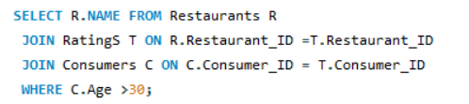
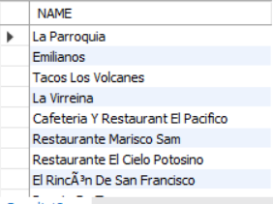
7. List restaurants (Name) that have received ratings from consumers older than 30.

Slide 18
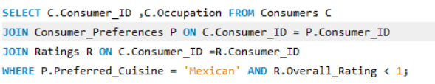
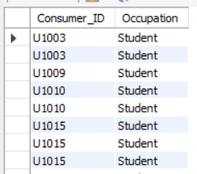
8. Find the Consumer_ID and Occupation of consumers whose preferred cuisine is 'Mexican' and who have given an Overall_Rating of 0 to at least one restaurant (any restaurant).

Slide 19
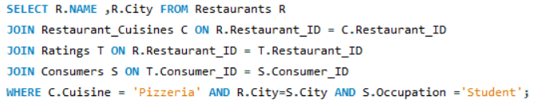
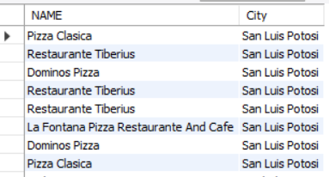
9. List the names and cities of restaurants that serve 'Pizzeria' cuisine and are located in a city
where at least one 'Student' consumer lives.

Slide 20
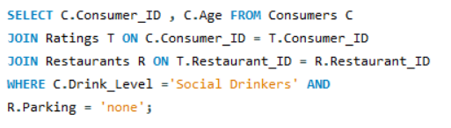
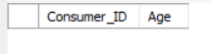
10 .Find consumers (Consumer_ID, Age) who are 'Social Drinkers' and have rated a restaurant that has 'No' parking.

Slide 21
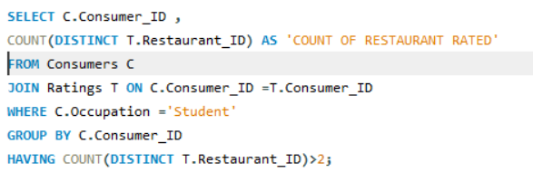
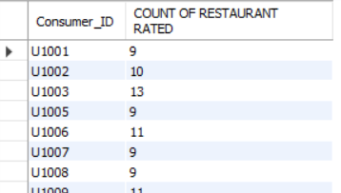
WHERE Clause and Order of Execution :
1. List Consumer_IDs and the count of restaurants they've rated, but only for consumers who are 'Students'. Show only students who have rated more than 2 restaurants.

Slide 22
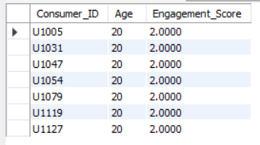
2 . We want to categorize consumers by an 'Engagement_Score' which is their Age divided by 10 (integer division).
List the Consumer_ID, Age, and this calculated Engagement_Score, but only for consumers whose Engagement_Score would be exactly 2 and who use 'Public'

Slide 23
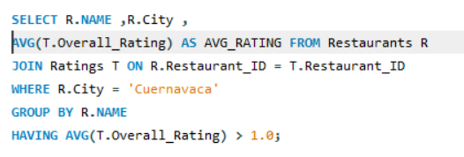
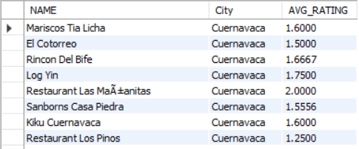
3. For each restaurant, calculate its average Overall_Rating. Then, list the restaurant Name, City, and its calculated average Overall_Rating, but only for restaurants located in 'Cuernavaca' AND whose calculated average Overall_Rating is greater than 1.0.

Slide 24
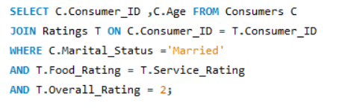
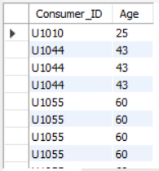
4. Find consumers (Consumer_ID, Age) who are 'Married' and whose Food_Rating for any restaurant is equal to their Service_Rating for that same restaurant, but only consider ratings
where the Overall_Rating was 2.

Slide 25
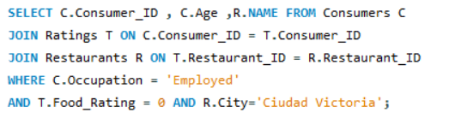
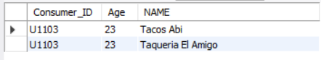
5. List Consumer_ID, Age, and the Name of any restaurant they rated, but only for consumers who are 'Employed' and have given a Food_Rating of 0 to at least one restaurant located in
'Ciudad Victoria'.

Slide 26
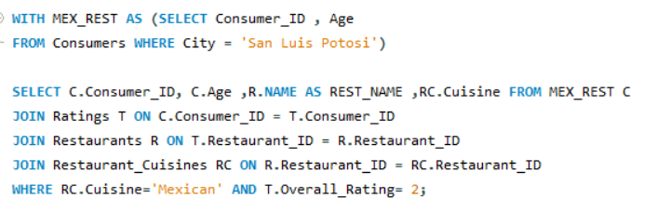
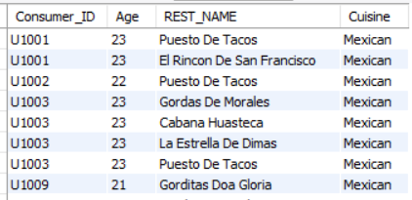
Advanced SQL Concepts:
1. Using a CTE, find all consumers who live in 'San Luis Potosi'. Then, list their Consumer_ID, Age, and the Name of any Mexican restaurant they have rated with an Overall_Rating of 2.

Slide 27
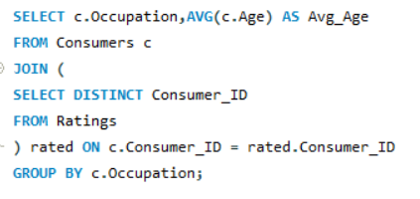
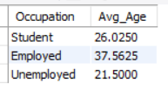
2. For each Occupation, find the average age of consumers. Only consider consumers who have made at least one rating. (Use a derived table to get consumers who have rated).

Slide 28
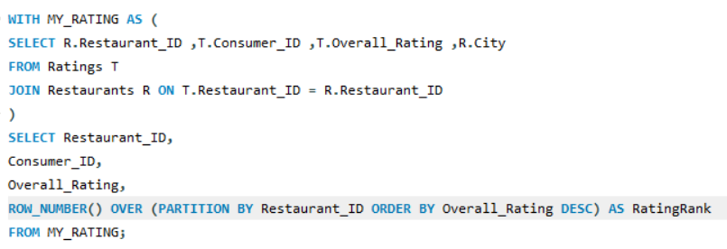
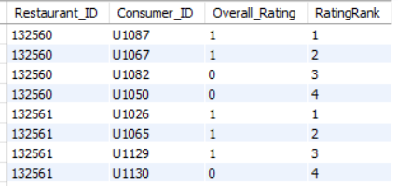
3 . Using a CTE to get all ratings for restaurants in 'Cuernavaca', rank these ratings within each restaurant based on Overall_Rating (highest first). Display Restaurant_ID, Consumer_ID, Overall_Rating, and the RatingRank.

Slide 29
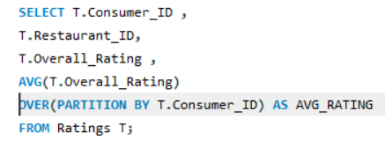
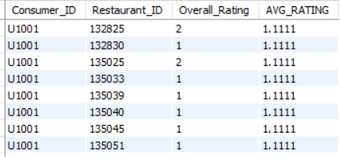
4. For each rating, show the Consumer_ID, Restaurant_ID, Overall_Rating, and also display the average Overall_Rating given by that specific consumer across all their ratings.

Slide 30
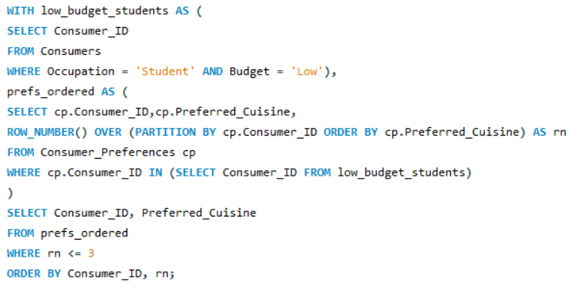

5. Using a CTE, identify students who have a 'Low' budget. Then, for each of these students, list their top 3 most preferred cuisines based on the order they appear in the
Consumer_Preferences table (assuming no explicit preference order, use Consumer_ID,
Preferred_Cuisine to define order for ROW_NUMBER).

Slide 31


6.Consider all ratings made by 'Consumer_ID' = 'U1008'. For each rating, show the
Restaurant_ID, Overall_Rating, and the Overall_Rating of the next restaurant they rated (if
any), ordered by Restaurant_ID (as a proxy for time if rating time isn't available). Use a
derived table to filter for the consumer's ratings first.

Slide 32


7. Create a VIEW named HighlyRatedMexicanRestaurants that shows the Restaurant_ID, Name and City of all Mexican restaurants that have an average Overall_Rating greater than 1.5.

Slide 33


8. First, ensure the HighlyRatedMexicanRestaurants view from Q7 exists. Then, using a CTE to find consumers who prefer 'Mexican' cuisine, list those consumers (Consumer_ID) who have not rated any restaurant listed in the HighlyRatedMexicanRestaurants view.

Slide 34



9. Create a stored procedure GetRestaurantRatingsAboveThreshold that accepts a
Restaurant_ID and a minimum Overall_Rating as input. It should return the Consumer_ID,Overall_Rating, Food_Rating, and Service_Rating for that restaurant where the Overall_Rating meets or exceeds the threshold.

Slide 35


10. Identify the top 2 highest-rated (by Overall_Rating) restaurants for each cuisine type. If there are ties in rating, include all tied restaurants. Display Cuisine, Restaurant_Name, City, and Overall_Rating.

Slide 36


11. First, create a VIEW named ConsumerAverageRatings that lists Consumer_ID and their average Overall_Rating. Then, using this view and a CTE, find the top 5 consumers by their average overall rating. For these top 5 consumers, list their Consumer_ID, their average rating, and the number of 'Mexican' restaurants they have rated.

Slide 37
12.Create a stored procedure named Get ConsumerSegmentAndRestaurantPerformance that accepts a Consumer_ID as input. The procedure should: 1. Determine the consumer's "Spending Segment" based on their Budget: 'Low' -> 'Budget Conscious' 'Medium' -> 'Moderate Spender' 'High' -> 'Premium Spender' NULL or other -> 'Unknown Budget' 2. For all restaurants rated by this consumer: List the Restaurant_Name. The Overall_Rating given by this consumer. The average Overall_Rating this restaurant has received from all consumers(not just the input consumer). A "Performance_Flag" indicating if the input consumer's rating for that restaurant is 'Above Average', 'At Average', or 'Below Average' compared to the restaurant's overall average rating. Rank these restaurants for the input consumer based on the Overall_Rating they gave (highest rating = rank 1).

Slide 38


Slide 39


Slide 40



Slide 41
CONCLUSION
This project helped us understand how SQL can find useful insights from restaurant and consumer data. We learned to design databases, write queries, and analyze real data. It improved our practical skills in SQL and data analysis for solving real business problems.

Slide 42

Any QUERIES ?

Slide 43
Thank
You..!

